Slide 1
Data Structures ICT-1211 Information and Communication Technology
Lecture-08
Date:

Slide 2
Arrays, Records and Pointers

Slide 3
Sorting
Let A be a list of n numbers. Sorting A refers to the operation of rearranging the elements of A so they are in increasing order.
i.e. so that A[a]<A[2]<A[3]<…....<A[N]
For example,
Suppose A originally is the list
8, 4, 19, 2, 7, 13, 5, 16
After sorting, A is the list
2, 4, 5, 7, 8, 13, 16, 19

Slide 4
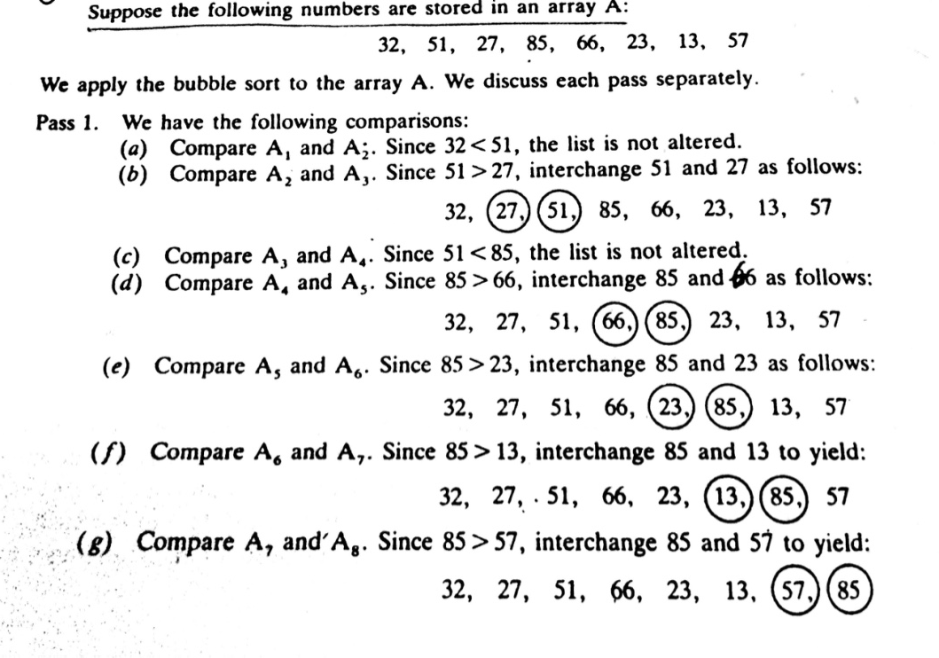
Sorting: BUBBLE SORT
At the end of the first pass, the largest number ,85 has moved to the last position.
Rest of the number are not sorted.

Slide 5
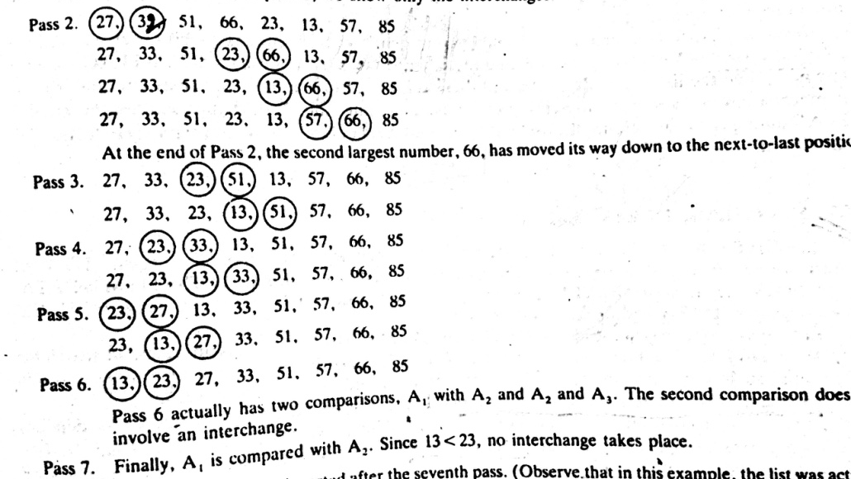
Sorting: BUBBLE SORT
Since the list has 8 elements, it is sorted after the seventh pass.

Slide 6
Bubble Sort: Algorithm
BUBBLE (DATA, N)
(Here DATA is an array with N elements. This algorithm sorts the elements in DATA)
Step 1. Repeat Steps 2 and 3 for K=1 to N-1.
Step 2. Set PTR:=1 [Initialize pass pointer PTR]
Step 3. Repeat while PTR<=N-K [Execute pass.]
(a) If DATA[PTR] > DATA[PTR+1], then:
Interchange Data[PTR] and DATA[PTR+1].
[End of IF Structure]
(b) Set PTR:=PTR+1.
[End of inner loop.]
[End of Step 1. outer loop.]
Step 4. Exit.

Slide 7
Complexity of BUBBLE SORT
Traditionally, the time for this sorting algorithm is measured in terms of the number of comparisons.
The number f(n) of comparisons in the bubble sort is easily computed.
Specifically, there are n-1 comparisons during the first pass, which placed the largest element to the last position; there are n-2 comparisons in the second step, which placed the second largest element in the next-to-the last position, and so on. Thus.
F(n)=(n-1)+(n-2)+….+2+1
=n(n-1)/2=n²/2+O(n)
=O(n²)

Slide 8
Searching
Searching refers to the operation of finding the location LOC of ITEM in Data, or printing some message that ITEM does not appear there.
The search is said to be successful if ITEM does appear in Data and unsuccessful otherwise.
There are many different searching algorithms. The algorithm that one chooses generally depends on the way the information is DATA is organized.
A simple searching algorithm: Linear Search Algorithm
The well known algorithm: Binary search Algorithm

Slide 9
Linear Search Algorithm
Suppose DATA is a linear array with n elements. Given no other information about DATA.
Simple way to search for a given ITEM in DATA is to compare ITEM with each element of DATA one by one.
Suppose we want to know whether Jhon appears in the array or not.
Again, Suppose, we want to know whether Moon appears in the array or not.
Adams
Charlie
Rasha
Moon
Rock
Smith
Adams
Charlie
Rasha
Moon
Rock
Smith
Jhon
Adams
Charlie
Rasha
Moon
Rock
Smith
Moon

Slide 10
Linear Search Algorithm: Example
Notes:
Here DATA is a linear array with N elements, and ITEN is a given item of information. This algorithm finds the location LOC of item in DATA, or sets LOC:=0 if the search is unsuccessful.

Slide 11
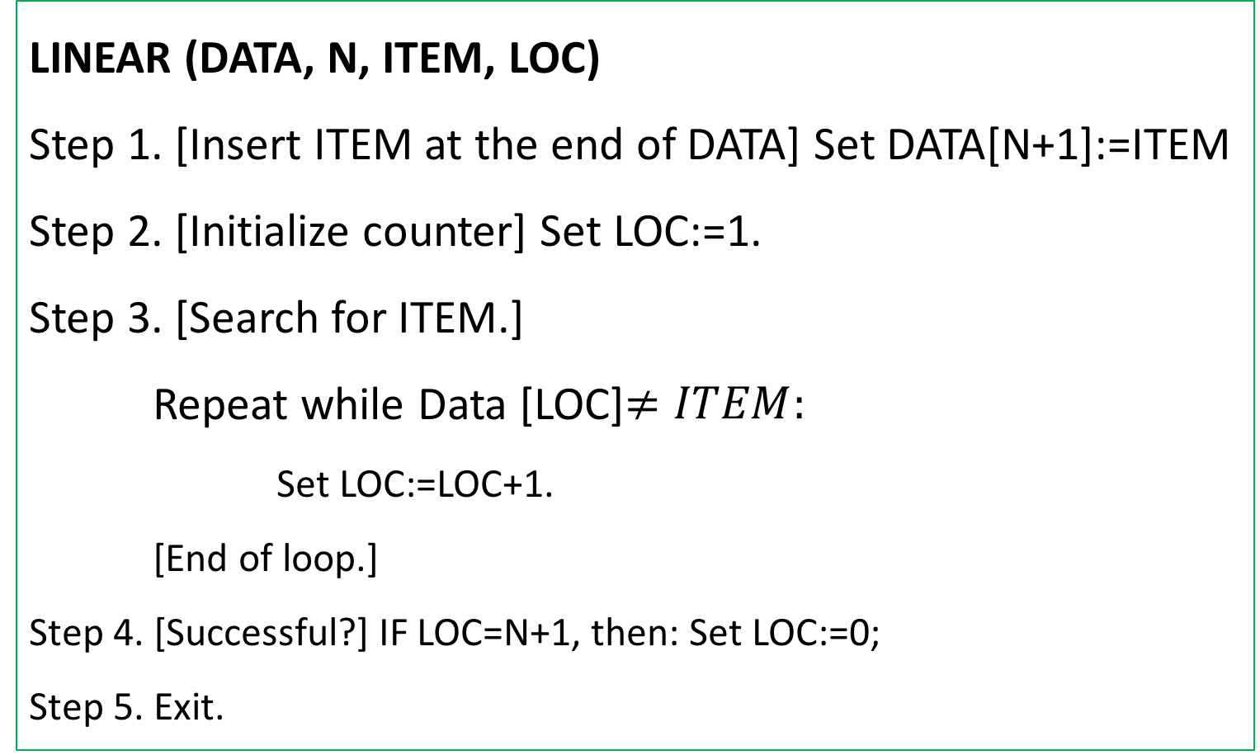
Searching: Linear Search Algorithm
LINEAR (DATA, N, ITEM, LOC)
Step 1. [Insert ITEM at the end of DATA] Set DATA[N+1]:=ITEM
Step 2. [Initialize counter] Set LOC:=1.
Step 3. [Search for ITEM.]
Repeat while Data [LOC]$≠ITEM:$
Set LOC:=LOC+1.
[End of loop.]
Step 4. [Successful?] IF LOC=N+1, then: Set LOC:=0;
Step 5. Exit.

Slide 12
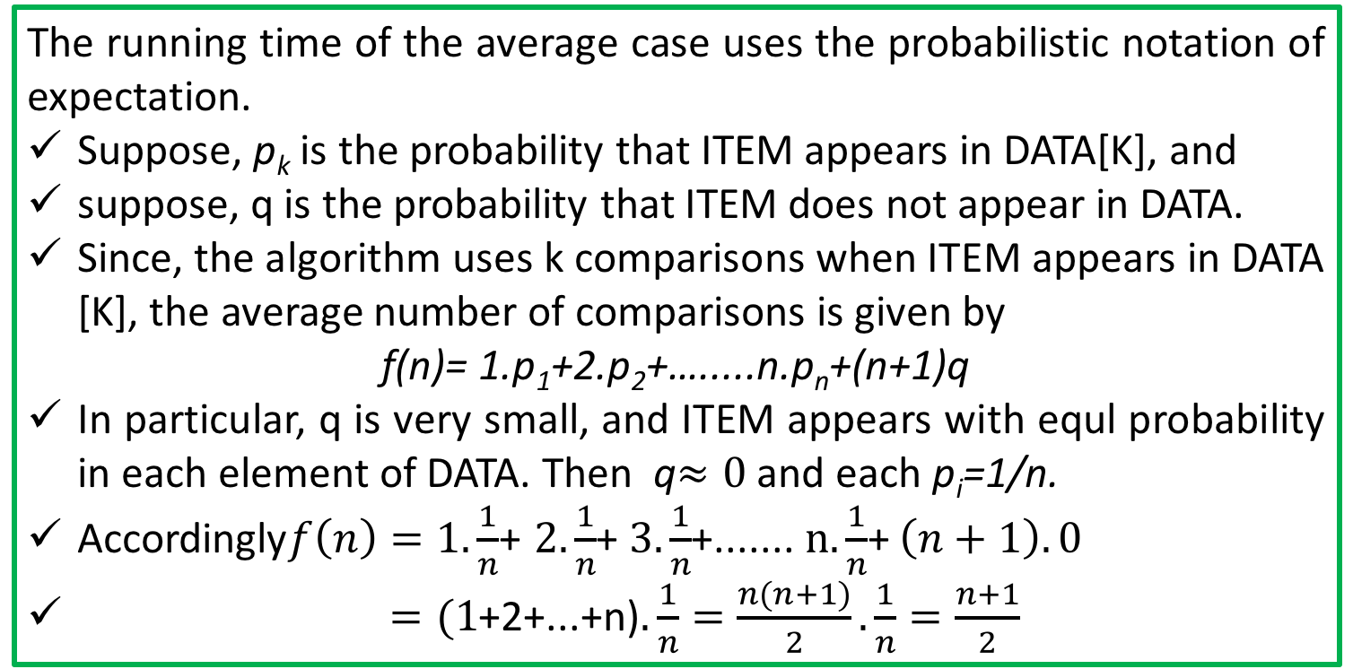
Linear Search Algorithm: Complexity
The complexity of this algorithm is measured by the number f(n) of comparison required to find ITEM where DATA contains n elements.
Two important cases to consider are:
The average case, and
The worst case
The running time of the average case uses the probabilistic notation of expectation.
Suppose, p_{k} is the probability that ITEM appears in DATA[K], and
suppose, q is the probability that ITEM does not appear in DATA.
Since, the algorithm uses k comparisons when ITEM appears in DATA [K], the average number of comparisons is given by
f(n)= 1.p₁+2.p₂+….....n.p_{n}+(n+1)q
In particular, q is very small, and ITEM appears with equl probability in each element of DATA. Then q$≈0$ and each p_{i}=1/n.
Accordingly$f\left(n\right)=1.\frac{1}{n}$+ $2.\frac{1}{n}$+ $3.\frac{1}{n}$+....... $n.\frac{1}{n}$+ $\left(n+1\right).0$
$=(1$+2+...+n)$.\frac{1}{n}=\frac{n(n+1)}{2}.\frac{1}{n}=\frac{n+1}{2}$
Notes:
That is, in this special case, the average number of comparison required to find the location of ITEM is approximately equal to half of the number of elements in the array

Slide 13
Linear Search Algorithm: Complexity
The worst case occurs when one must search through the entire array DATA, when ITEM does not appear in DATA.
Algorithm Requires f(n)= n+1 comparison.
Thus, in the worst case, the running time is proportional to n
Notes:
Here DATA is a linear array with N elements, and ITEN is a given item of information. This algorithm finds the location LOC of item in DATA, or sets LOC:=0 if the search is unsuccessful.

Slide 14
Binary Search:
Suppose DATA is an array which is sorted in INCREASING ORDER, or equivalently, alphabetically.
Then, Binary Search algorithm is an extremely efficient searching algorithm to find the location LOC of a given ITEM of information in DATA.
Binary search algorithm applied to array DATA works as follows:
DATA[BEG], DATA[BEG+1], DATA[BEG+2],…....., DATA[END]
This algorithm compares ITEM with the middle element DATA [MID] of the segment, where MID is obtained by
MID=INT((BEG+END)/2)
If DATA[MID]=ITEM, then the search is SUCCESSFUL.
We set LOC:=MID
....Otherwise a new segment of DATA is obtained.

Slide 15
Binary Search:
If ITEM < DATA[MID], then ITEM can appear only in the left half of the segment:
DATA[BEG], DATA[BEG+1], ….DATA[MID-1]
So, we resent END:=MID-1 and begin searching again.
(b) If ITEM> DATA[MID], then ITEM appear only in the right half of the segment:
DATA[MID+1], DATA[MID+2],...........DATA[END]
So, we reset BEG:=MID+1 and begin searching.
Initially, we begin with entire array DATA, i.e. We begin wit BEG=1 and END=n, or more generally, with BEG=LB and END=UB.
If ITEM is not in DATA, then eventually we obtain
END< BEG
Which means the search is Unsuccessful
So, SET LOC:=NULL (OUT side of DATA indices)
Notes:
Here DATA is a linear array with N elements, and ITEN is a given item of information. This algorithm finds the location LOC of item in DATA, or sets LOC:=0 if the search is unsuccessful.

Slide 16
Binary Search: : Example
Searching the array below for the value 42:
index | 0 | 1 | 2 | 3 | 4 | 5 | 6 | 7 | 8 | 9 | 10 | 11 | 12 | 13 | 14 | 15 | 16
value | -4 | 2 | 7 | 10 | 15 | 20 | 22 | 25 | 30 | 36 | 42 | 50 | 56 | 68 | 85 | 92 | 103
min
mid
max
Notes:
Here DATA is a linear array with N elements, and ITEN is a given item of information. This algorithm finds the location LOC of item in DATA, or sets LOC:=0 if the search is unsuccessful.

Slide 17
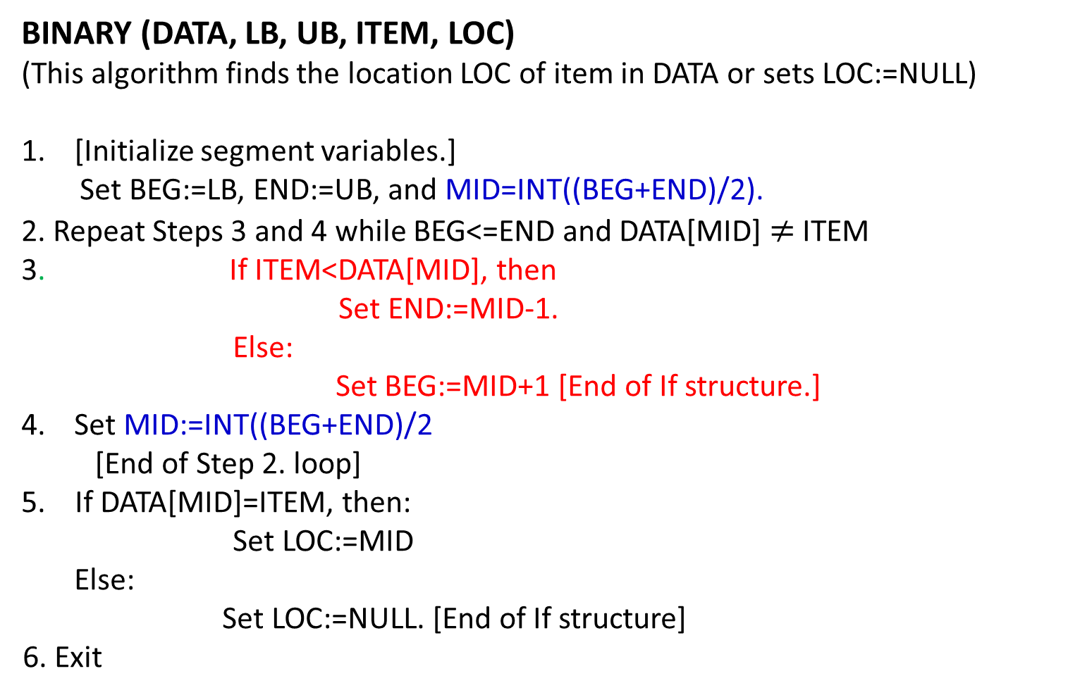
Binary Search: Algorithm
BINARY (DATA, LB, UB, ITEM, LOC)
(This algorithm finds the location LOC of item in DATA or sets LOC:=NULL)
[Initialize segment variables.]
Set BEG:=LB, END:=UB, and MID=INT((BEG+END)/2).
2. Repeat Steps 3 and 4 while BEG<=END and DATA[MID] $≠$ ITEM
3. If ITEM<DATA[MID], then
Set END:=MID-1.
Else:
Set BEG:=MID+1 [End of If structure.]
Set MID:=INT((BEG+END)/2
[End of Step 2. loop]
5. If DATA[MID]=ITEM, then:
Set LOC:=MID
Else:
Set LOC:=NULL. [End of If structure]
6. Exit
Notes:
Here DATA is a linear array with N elements, and ITEN is a given item of information. This algorithm finds the location LOC of item in DATA, or sets LOC:=0 if the search is unsuccessful.

Slide 18

Binary Search: Limitations
Your Task
Notes:
Here DATA is a linear array with N elements, and ITEN is a given item of information. This algorithm finds the location LOC of item in DATA, or sets LOC:=0 if the search is unsuccessful.

Slide 19
Thank you……

